Slide 1
1 Introduction to Materials Science for Engineers
One material is chosen over another for a particular application because its properties are better suited for the intended use. Among the important properties are strength, corrosion resistance, electrical conductivity, weight, material cost, processing costs, and appearance. Usually several properties are important [1].

Slide 2
Materials were found before thousands of years ago. Therefore, different ages have been seen, as shown below:
• Stone tools = Stone Age
• 4000 – 2000 BC Copper Age
• 2000 – 1000 BC Bronze Age, i.e. (Cu,Sn) alloys, invention of metallurgy
• 1000 – 1 BC Iron Age
• ˜ 1650 Classical physics - Mechanics
• ˜ 1800 Metallography / Crystallography
• ˜ 1900 Physical Metallurgy, Crystal Physics, Statistical Physics, Modern
Physics, Solid State Physics
• ˜ 1950 Materials Science and Engineering
• ˜ 1955 Silicon (electronic materials, information technology) Age
• 21st century Nanoscience and Technology

Slide 3
1.1 Types of materials
Generally speaking materials can be classified into different groups, as listed below [2]:
1.1.1 Metals
• Iron and Steel (Ferrous alloys; i.e. Iron based alloys)
• Alloys and Super alloys (Nonferrous alloys; not iron based, i.e. Al, Cu, Mg, Ti, Ni, Au and ….)
• Intermetallic Compounds (high structural materials)
1.1.2 Ceramics
• Structural Ceramics (high-temperature load bearing)
• Refractories (corrosion-resistant, insulating)
• Whitewares (e.g. porcelains)
• Glass
• Electrical Ceramics (capacitors, insulators, transducers, etc.)
• Chemically Bonded Ceramics (e.g. cement and concret

Slide 4
1.1.3 Polymers
• Thermoplastic
• Thermoset
1.1.4 Electronic Materials
• Silicon and Germanium
• Compounds (e.g. GaAs)
• Photonic materials (solid-state lasers, LEDs)
1.1.5 Composites
• Particulate composites (small particles embedded in a different material)
• Laminate composites (golf club shafts, tennis rackets)
• Fibre reinforced composites (e.g. fiberglass)
Or can also be classified in a metal or polymer or ceramic matrix composite, which are normally denoted to MMC, PMC and CMC respectively.
1.1.6 Biomaterials (really using previous 5, but bio-mimetic)
• Man-made proteins (cytoskeletal protein rods or “artificial bacterium”)
• Biosensors (Au-nanoparticles stabilized by encoded DNA for anthrax detection)
• Drug-delivery colloids (polymer based)

Slide 5
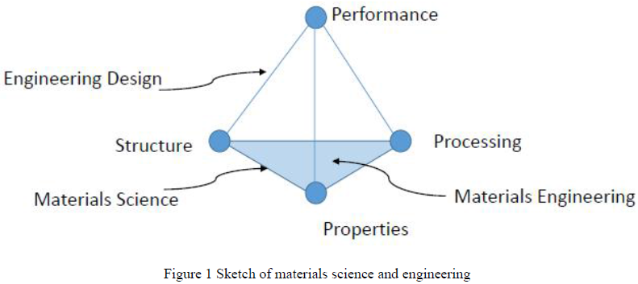
It is worth to note that there are different terms which are engineering design, material engineering and material science. Those terms are widely used in this field of study, the sketch in Figure 1 can explain those terms:

Slide 6
Basic properties of the materials can be summarised into seven categories as shown below [3]:
• Physical properties ( i.e. density and melting point)
• Mechanical properties (which are related to the applied load; such as strength, hardness, wear and ...)
• Electrical properties ( i.e. resistivity and conductivity)
• Thermal properties ( i.e. thermal conductivity and heat capacity)
• Optical properties ( i.e. refractive index and transmissivity)
• Chemical properties ( i.e. corrosion and solvent resistance)
• Magnetic properties

